Slide 1
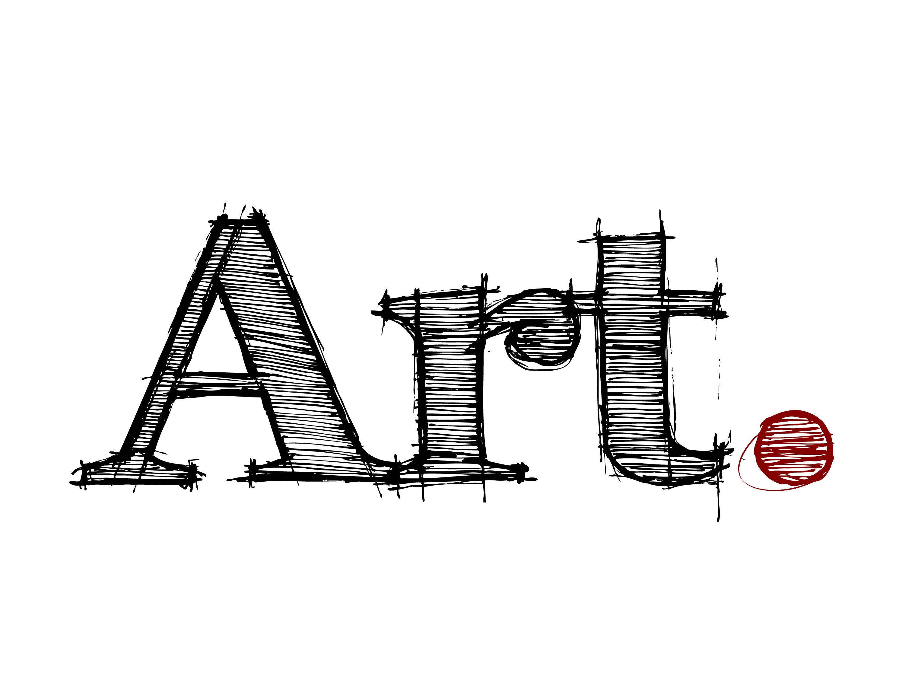
by Javier Macossay-Hernández

Slide 2
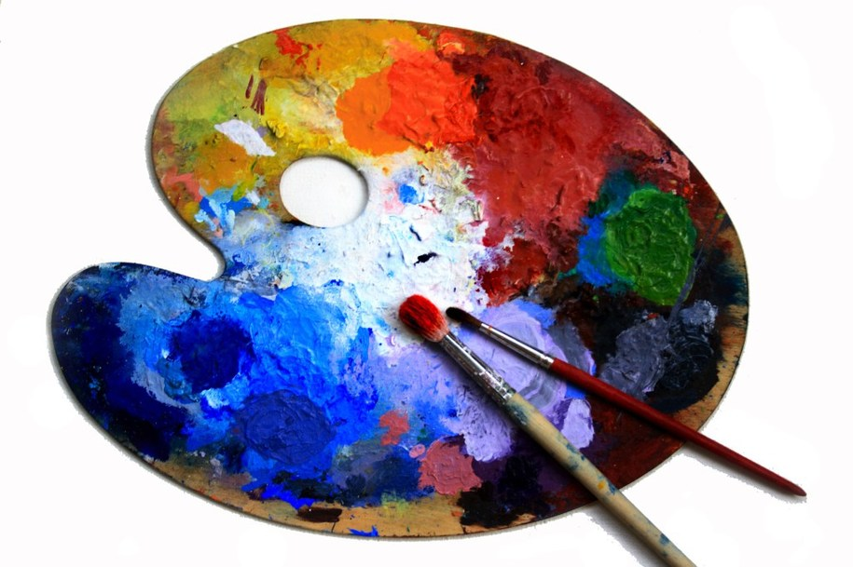
By definition
Art expresses creativity of the human being.
It engages reality through imagination.
The artist transforms material to a desired form according to the inspiration.

Slide 3
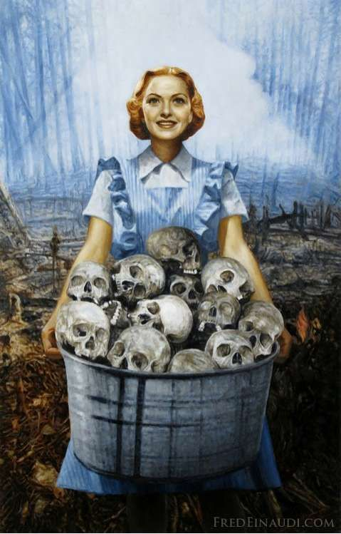
Bad Art
The art that promotes violence or glamorizes evil is bad art.
Art has an aim, which is connecting humanity.

Slide 4
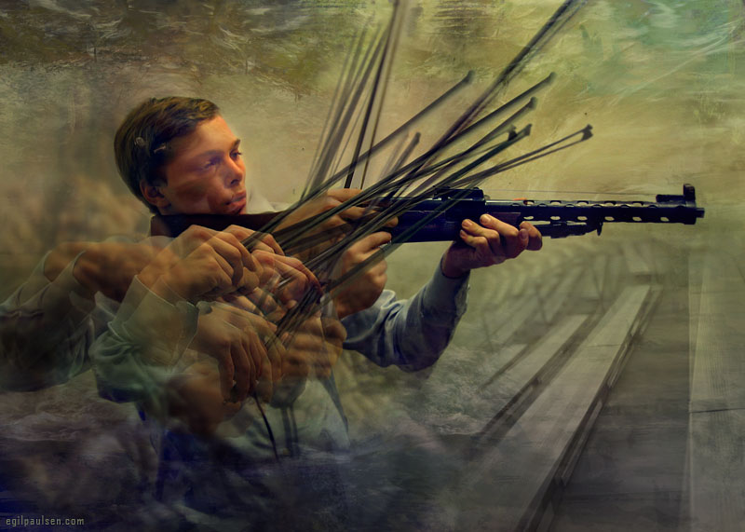

Slide 5
